Slide 1
Performing recon from the wan
Samuel DePriest
09/05/2024

Slide 2
Objective
Performing recon from an external IP from the WAN within the topology. Use tools to capture user credentials, and with those log into and compromise the system.
Tools:
Nmap
Kali
Zenmap
Metasploit
John The Ripper
netcat

Slide 3
Introduction
In this lab, you will be performing reconnaissance from an external IP address from the WAN (wide area network) within this topology. Figure 1 shows the lab topology for this lab. You are using a Kali 2 Attack Machine, which is external to the network, to scan the pfSense firewall to determine what ports are open on the pfSense firewall. In this case, the pfSense firewall is port forwarding to either the internal Windows Server or the internal Metasploitable machine running Linux. There are several parts of the lab you will be exploring:
In Step 1 of the lab, you will perform banner grabbing by connecting to the external IP address of the pfSense firewall. You will also perform a scan using nmap in order to determine the different ports that are open.
In Step 2 of the lab, you will attempt to determine what the operating system and applications are running on the internal machines behind the external facing firewall. For example, you will be able to determine that the Telnet is port forwarding to a Linux distribution running Metasploitable.
In Step 3, you will read the contents of the /etc/shadow file and get the salted password hash for the administrator account.
In the final step, you will log in to the Microsoft Windows Server through a Remote Desktop Protocol (RDP) session with those credentials. You will now have access to the Windows Server.

Slide 4
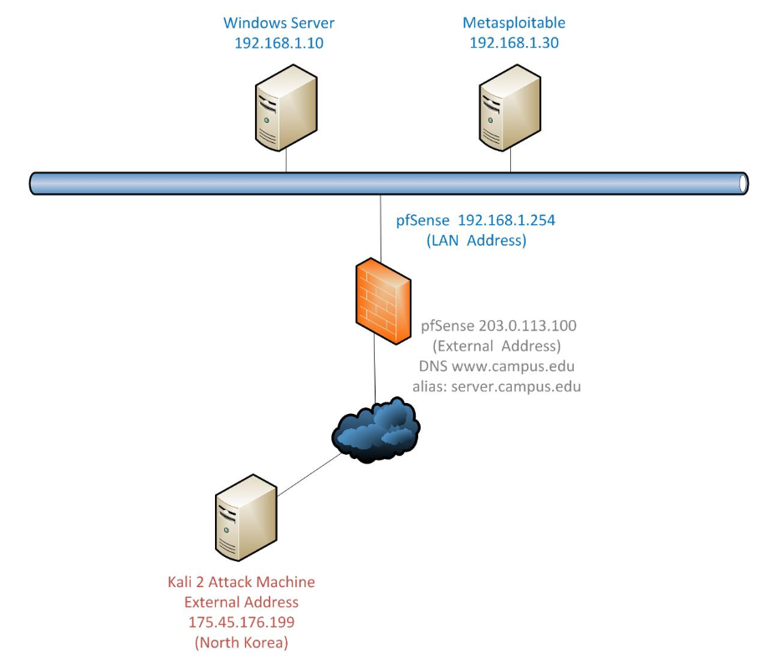
Topology

Slide 5
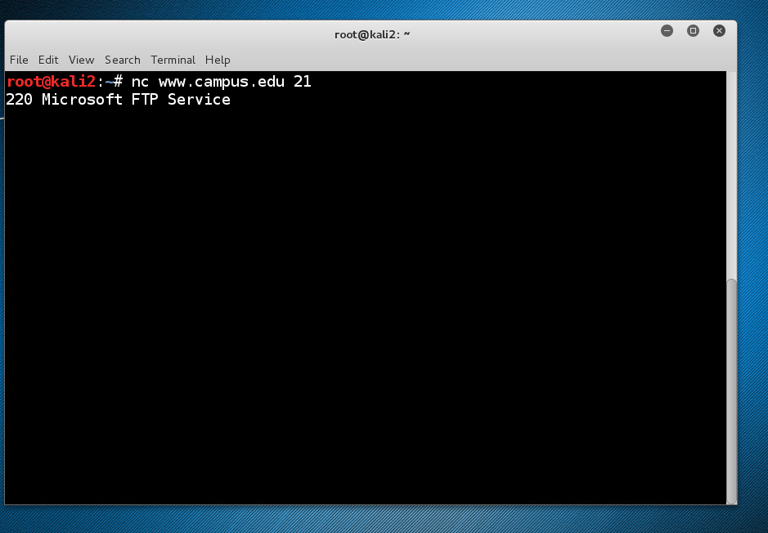
Using netcat to banner grab for service info

Slide 6
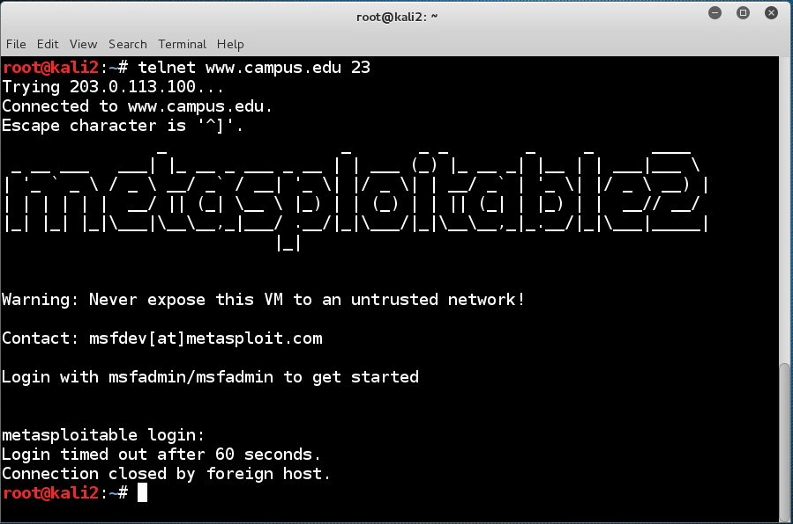
Using telnet to banner grab for service info

Slide 7
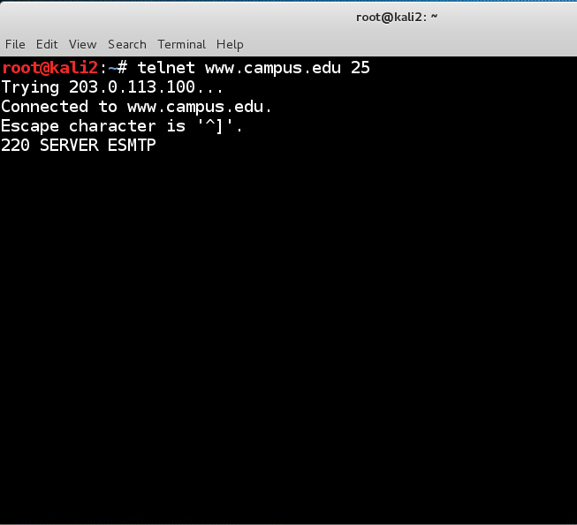
Using telnet to banner grab for service info

Slide 8
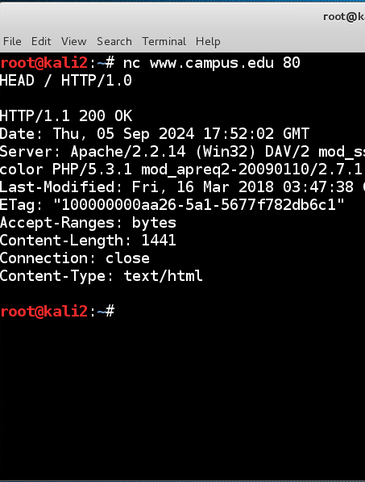
Using netcat to banner grab for service info

Slide 9
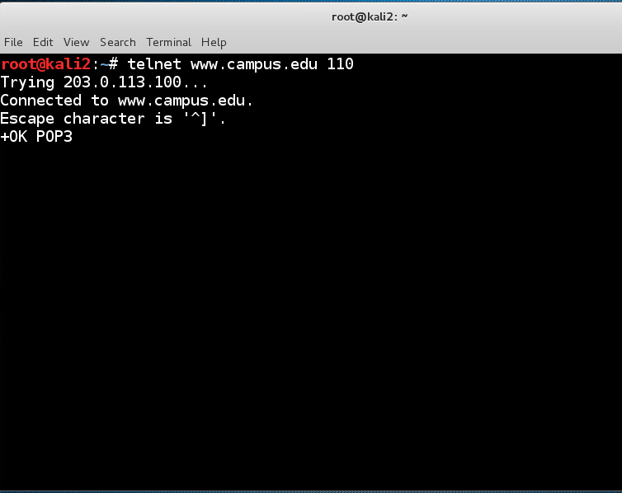
Using telnet to banner grab for service info

Slide 10
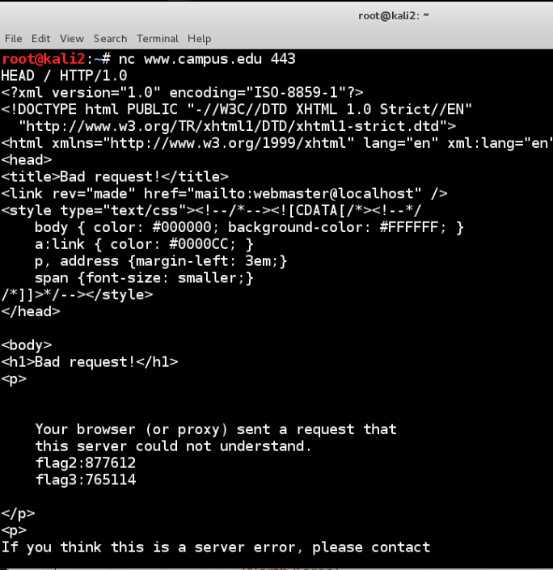
Using Netcat to banner grab for service info and discover flags

Slide 11
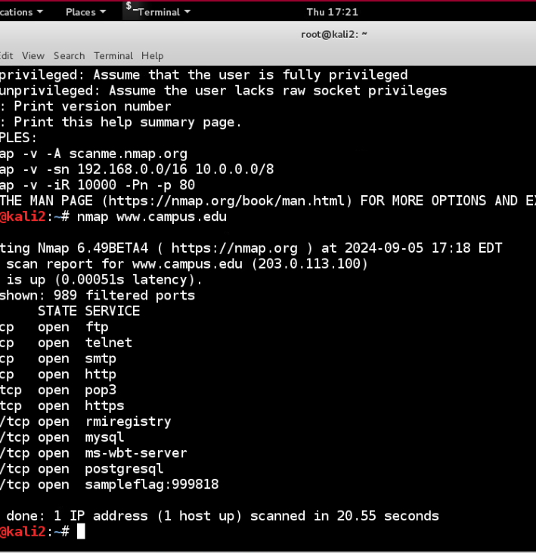
Using nmap with to scan for open ports on the firewall

Slide 12
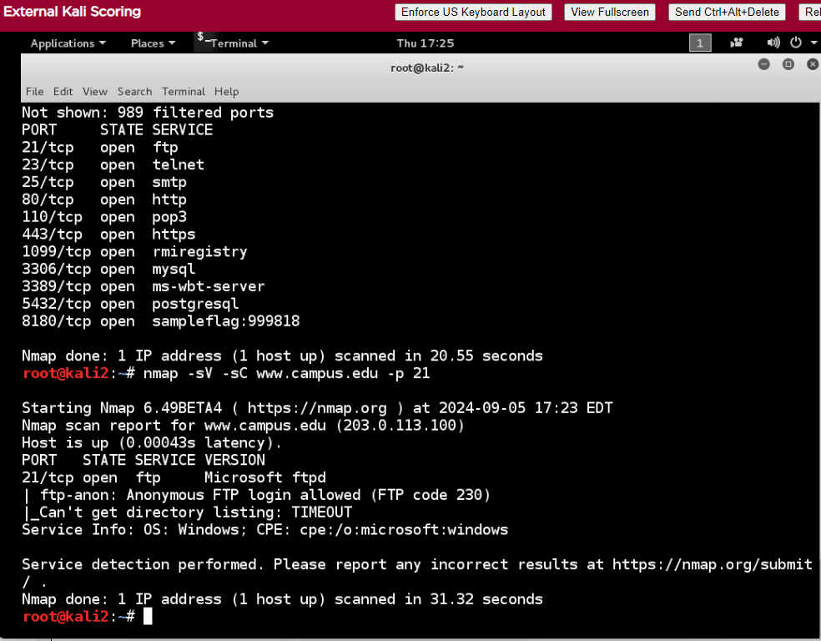
Using nmap with version scan and script scan on port 21(ftp)

Slide 13
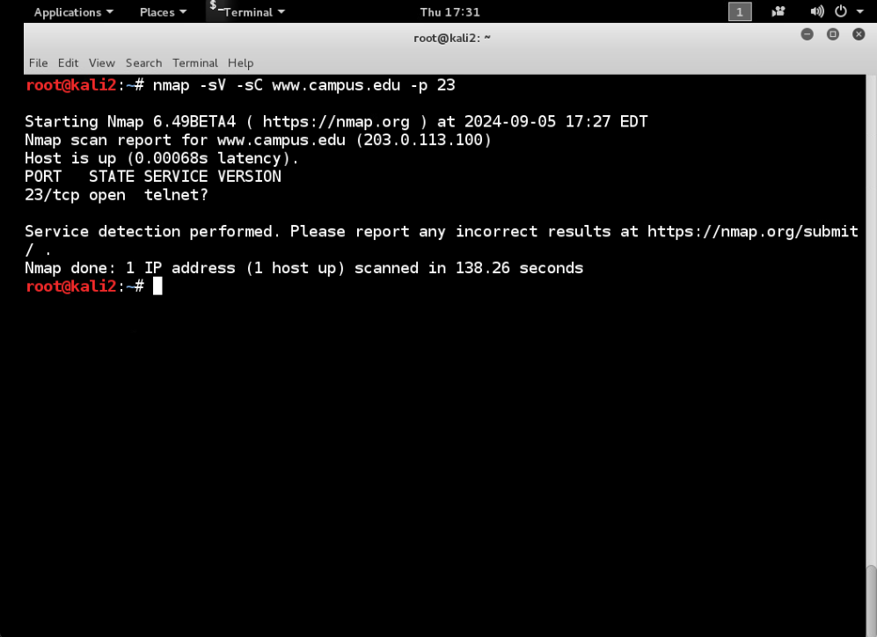
Using nmap with version scan and script scan on port 23(telnet)

Slide 14
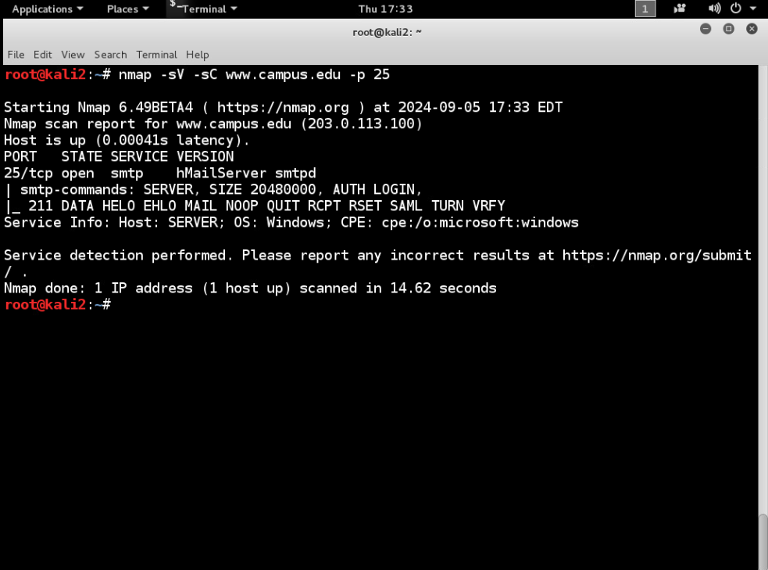
Using nmap with version scan and script scan on port 25(smtp)

Slide 15
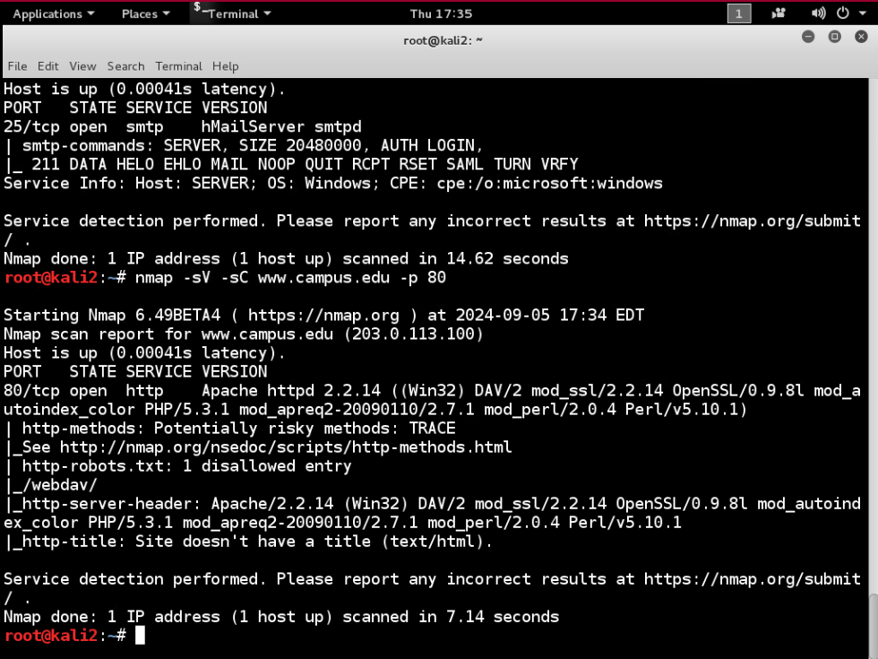
Using nmap with version scan and script scan on port 80(http)

Slide 16
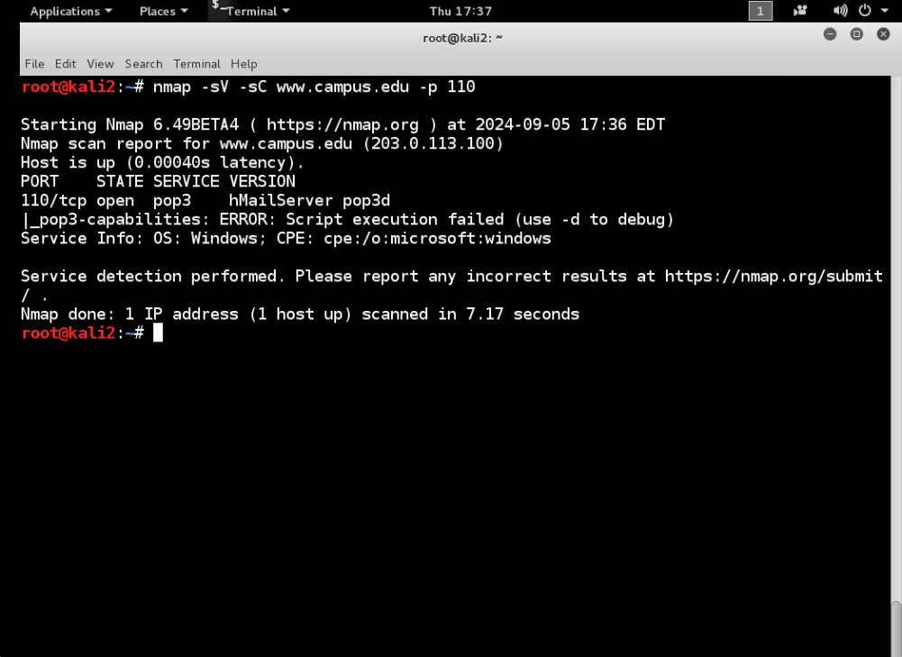
Using nmap with version scan and script scan on port 110(pop3)

Slide 17
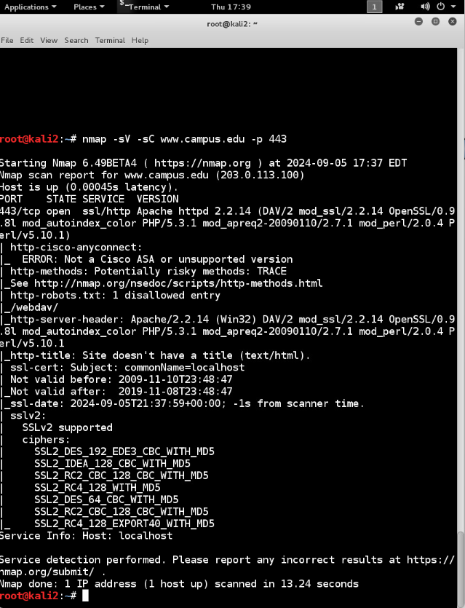
Using nmap with version scan and script scan on port 443(https)

Slide 18
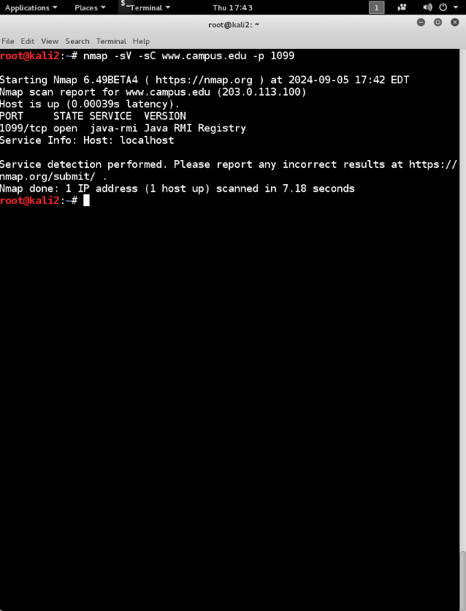
Using nmap with version scan and script scan on port 1099(rmiregistry)

Slide 19
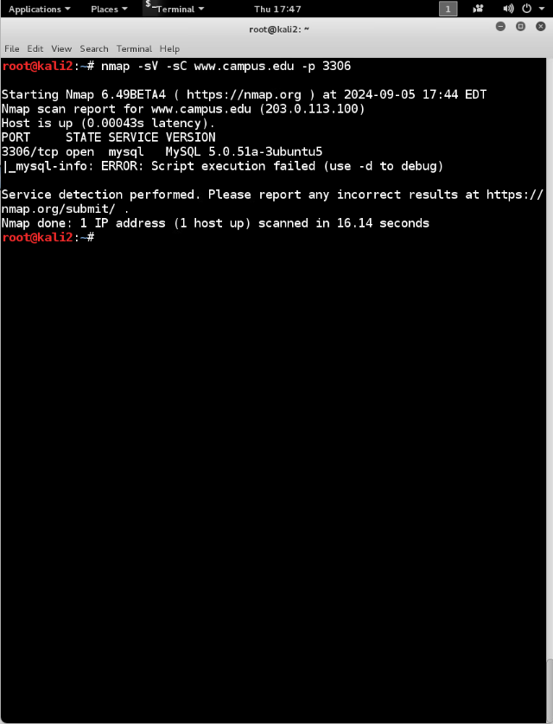
Using nmap with version scan and script scan on port 3306(mysql)

Slide 20
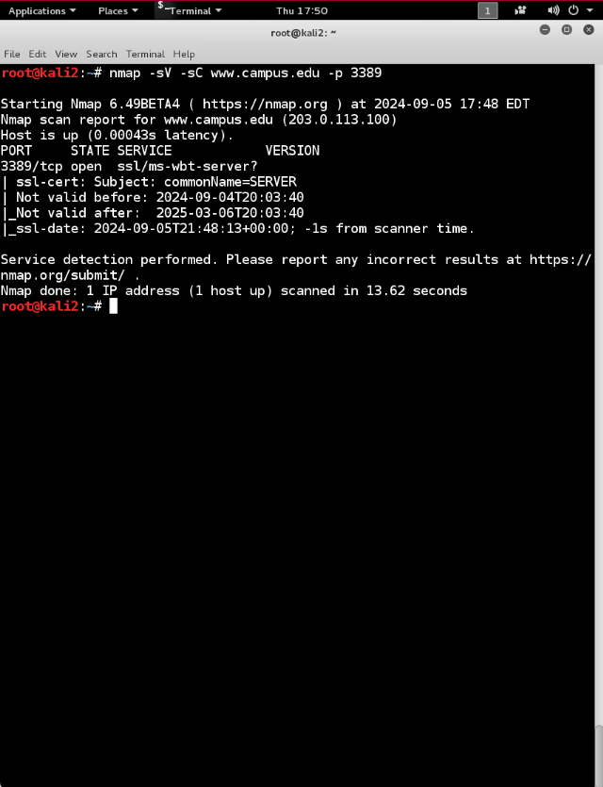
Using nmap with version scan and script scan on port 3389(ms-wbt-server)

Slide 21
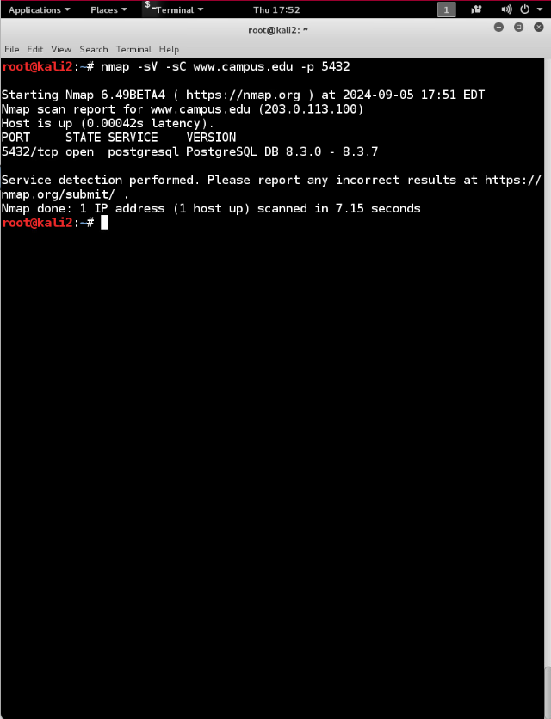
Using nmap with version scan and script scan on port 5432(postgresql)

Slide 22
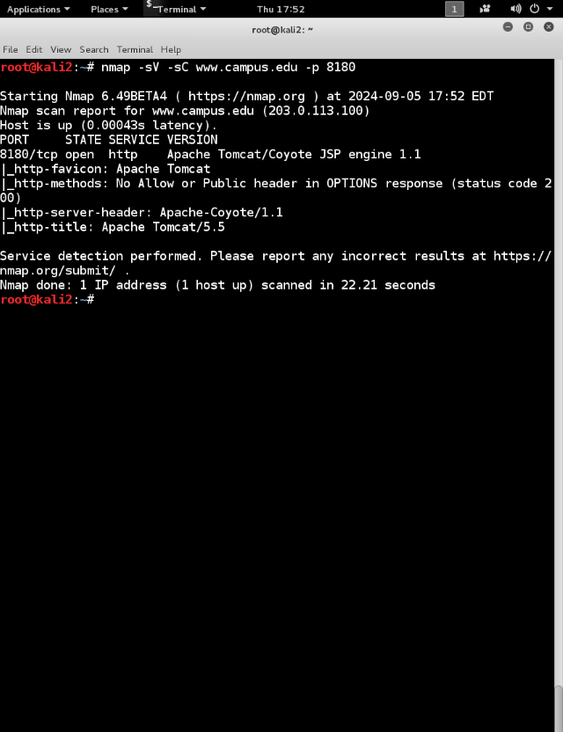
Using nmap with version scan and script scan on port 8180(unknown)

Slide 23
Analysis
The scanning and banner grabbing has determined the firewall is redirecting to both Linux and Windows systems.

Slide 24
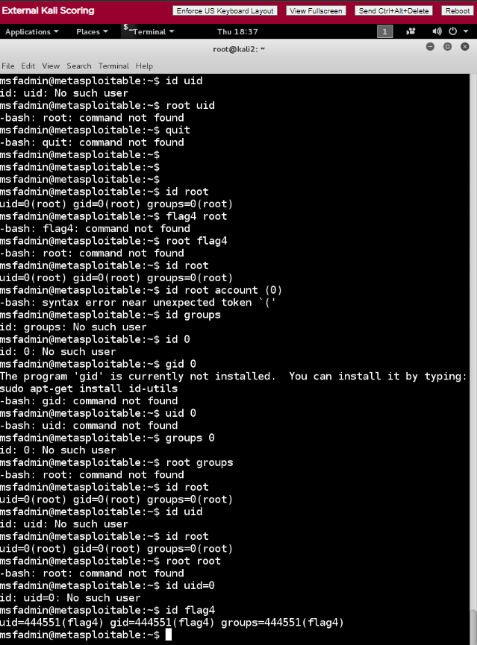
Using Metasploit on telnet www.campus.edu id root to snag the UID for Flag 4

Slide 25
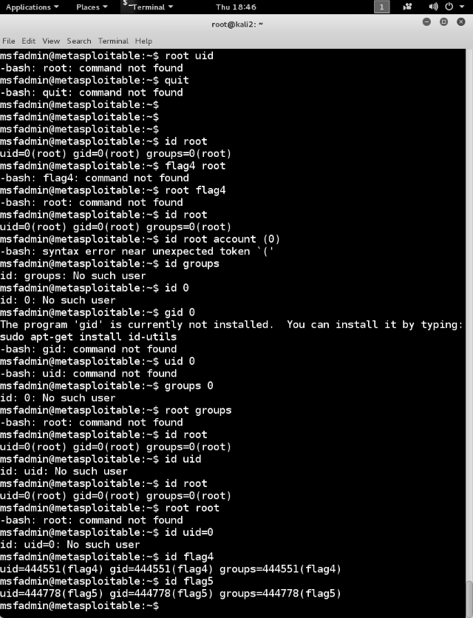
Using Metasploit on telnet www.campus.edu id root to snag the UID for Flag 5

Slide 26
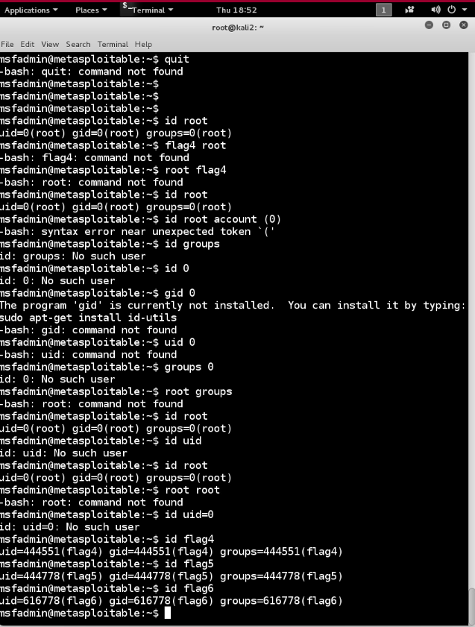
Using Metasploit on telnet www.campus.edu id root to snag the UID for Flag 6

Slide 27
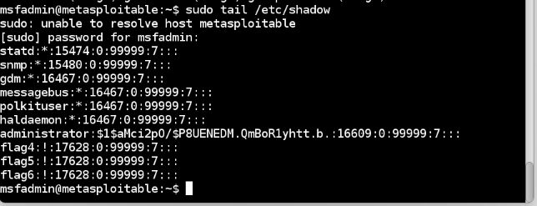
Viewing hashes in the shadow file

Slide 28
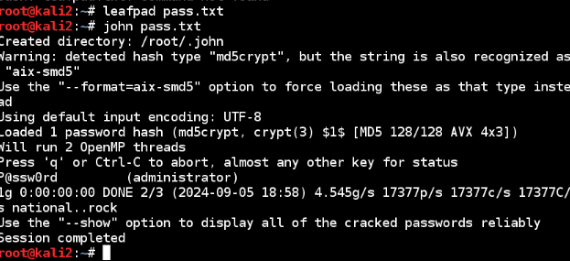
We then created a pass.txt file with the hash pass to use john the ripper to crack it

Slide 29
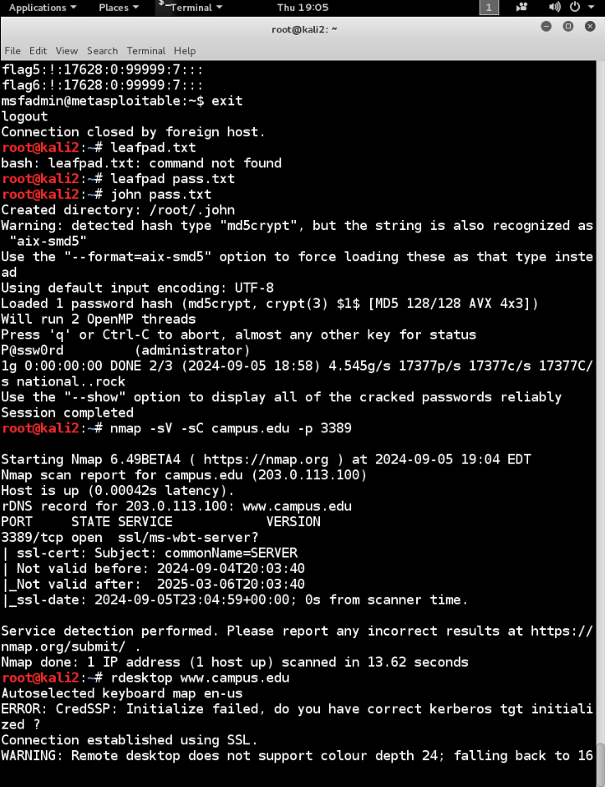
Gaining remote access to port 3389

Slide 30
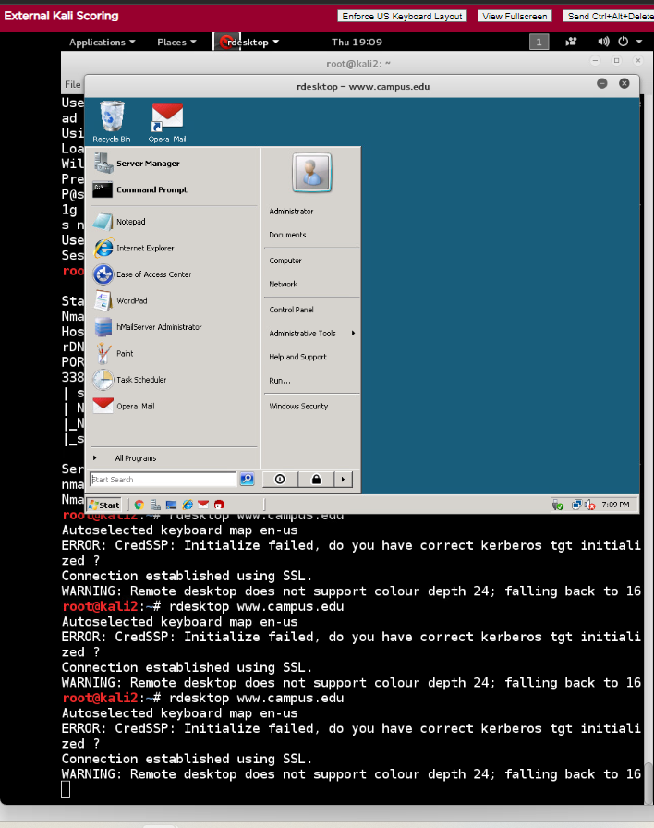
Successful login on admin account

Slide 31
conclusion
We were able to utilize the tools provided to grab banner headings,and scan for open ports. Once one that was found with a known vuln we could use, we used Metasploit to find the shadow text file to get the admin hash, sued john the ripepr to crack it. Then used rdesktop to remote in and gain access to the admin account.

